Slide 1

XGBoost: Regularization Framework-Tree Complexity Penalties
By Audrey Su, Datasci 224

Slide 2
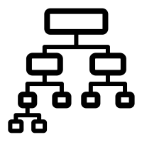
XGBoost versus Gradient Boosted Trees

Slide 3
How XGBoost Differs From Gradient Boosted Trees
Gradient Boosted Trees: an ensemble learning method that builds decision trees sequentially using boosting
starts off by fitting an initial “weak learner” decision tree to the data
at each training iteration computes the negative gradient of the loss function with respect to the current predictions to help create a new decision tree that attempts to correct the errors of the previous ensemble
XGBoost: an ensemble learning method that builds decision trees sequentially using boosting that was created with the intention of improving the Gradient Boosted Trees algorithm
Faster
More accurate
More scalable
More resistant to overfitting [1]

Slide 4

XGBoost’s Regularization Framework

Slide 5
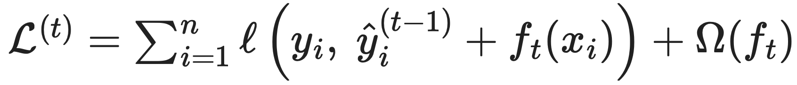
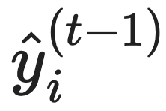
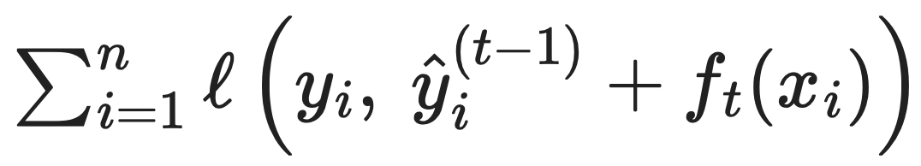
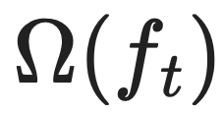





Regularized Objective Function
$$n$$
= number of rows in dataset
$$t$$
= iteration number of XGBoost algorithm
$$x_{i}$$
= feature vector for the ith row in the dataset
$$y_{i}$$
= the true label for the ith row in the dataset
= the ensemble’s prediction for row i, calculated before adding decision tree trained at iteration t to the ensemble
$$f_{t}$$
= decision tree that was trained at iteration t
is the loss function
the regularization term [1]

Slide 6



The Regularization Term
$$f_{t}$$
= decision tree that was trained at iteration t
= number of leaves in the decision tree trained at iteration t
The purpose of the regularization term is to penalize each decision tree trained at each iteration t for being too complex so that the overall ensemble of decision trees can generalize better to unseen data
Helps to prevent decision trees from memorizing noise or variations specific only to the training data
Instead incentivizes decision trees to learn overall patterns in the training data [1]
$$T$$
$$w_{j}$$
= weights for the leaves of the decision tree trained at iteration t

Slide 7
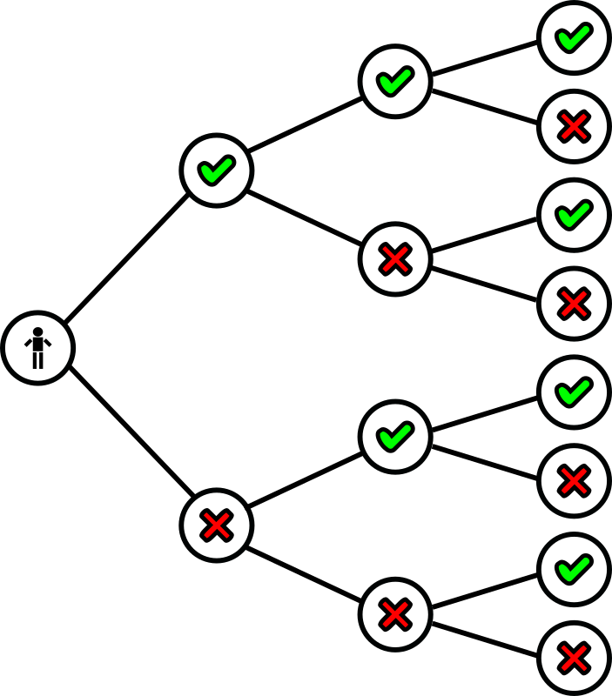
Tree Complexity Penalties

Slide 8



Leaf Count Penalty
$$γT$$
$$γ$$
= “cost” assigned for every additional leaf added to the decision tree trained at iteration t
This penalty term discourages each decision tree from having too many leaves
This helps to control size and depth of each decision tree
Attempts to make each decision tree simpler [2]
$$T$$
= number of leaves in the decision tree trained at iteration t

Slide 9





L2 (Ridge) Leaf Weight Regularization
$$\frac{1}{2}λ\sum_{j=1}^{T}{w_{j}^{2}}$$
$$w_{j}$$
= weights for the leaves of the decision tree trained at iteration t
$$T$$
= number of leaves in the decision tree trained at iteration t
$$λ$$
= “cost” assigned to the sum of the squared weights
Discourages each leaf of each decision tree from having a large weight $w_{j}$
Attempts to shrink each $w_{j}$ to approach 0
Prevents any single leaf from dominating the calculation when each decision tree generates a prediction [2]

Slide 10




L1 Leaf Weight Regularization (LASSO)
$$α\sum_{j=1}^{T}{{|w}_{j}|}$$
$$w_{j}$$
= weights for the leaves of the decision tree trained at iteration t
$$T$$
= number of leaves in the decision tree trained at iteration t
$$α$$
= “cost” assigned to the sum of the absolute value of the weights
Also discourages each leaf of each decision tree from having a large weight $w_{j}$
Has the ability to shrink leaf weights to exactly 0
Shrinks leaf weights more aggressively than L2 Leaf Weight Regularization
Can result in sparser decision trees
Note: optional penalty term that isn’t used in all implementations of XGBoost [2]

Slide 11

Research Question: Among a cohort of patients part of The Cancer Genome Atlas Program with glioma, how well can machine learning classify the patients as having either Lower-Grade Glioma or Glioblastoma Multiforme?

Slide 12
How XGBoost Will Help Answer My Research Question
Dataset: consists of 839 patients with glioma, and 23 genes and clinical features such as gender, age at diagnosis, and whether tumor protein p53 was mutated or not [3]
Split the dataset so that 70% is training set, 30% is test set
XGBoost will be applied on the dataset to classify patients as either having Lower-Grade Glioma or Glioblastoma Multiforme
XGBoost is a strong machine learning model to use for this classification task because its regularization term in its regularized objective function has built-in support to help prevent overfitting
Especially useful because the dataset only contains 839 patients
XGBoost also has been demonstrated to perform well in classification tasks for healthcare [4]

Slide 13
Sources
[1] Tianqi Chen and Carlos Guestrin. 2016. XGBoost: A Scalable Tree Boosting System. In Proceedings of the 22nd ACM SIGKDD International Conference on Knowledge Discovery and Data Mining (KDD '16). Association for Computing Machinery, New York, NY, USA, 785–794. https://doi.org/10.1145/2939672.2939785
[2] Guillaume, S. (2022, February 24). Visually understand XGBoost, LightGBM and CatBoost Regularization Parameters. Towards Data Science. https://towardsdatascience.com/visually-understand-xgboost-lightgbm-and-catboost-regularization-parameters-aa12abcd4c17/
[3] Tasci, E., Zhuge, Y., Kaur, H., Camphausen, K., & Krauze, A. V. (2022). Hierarchical Voting-Based Feature Selection and Ensemble Learning Model Scheme for Glioma Grading with Clinical and Molecular Characteristics. International Journal of Molecular Sciences, 23(22), 14155.
[4] Rafie, Z., Talab, M. S., Koor, B. E. Z., Garavand, A., Salehnasab, C., & Ghaderzadeh, M. (2025). Leveraging XGBoost and explainable AI for accurate prediction of type 2 diabetes. BMC public health, 25(1), 3688. https://doi.org/10.1186/s12889-025-24953-w

Slide 14
Any questions?

